Slide 1
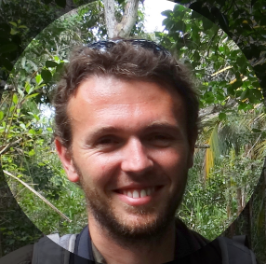
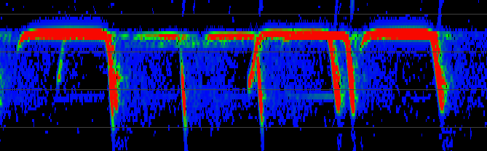
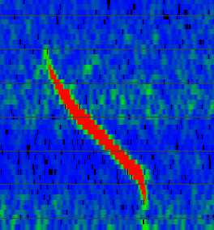
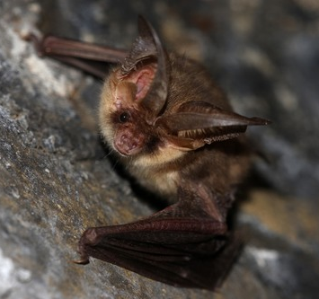
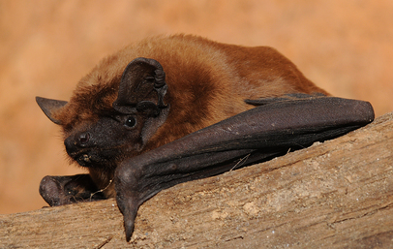
Citizens and machines monitor bats together: lessons from 15 years of acoustic monitoring in France and perspectives at the European scale
Charlotte Roemer, Yves Bas, Kévin Barré, Christian Kerbiriou, Stuart Newson, Adeline Comte, Jean-François Julien
© Martin Grimm
©jpreudhomme
© Jan Svetlik
Notes:
Thanks Niamh/Daniel, hello everyone, I’ll present some features of and feedback from the Vigie-Chiro programme that we are coordinating with colleagues from the French National Museum of Natural History,
this programme has benefited from some collaborations, especially from Stuart Newson from British Trust for Ornithology that will present his amazing experience in the UK right after me!
So our programme involves acoustic monitoring, machine learning and of course citizen science

Slide 2
Methods for data collection and analysis

Slide 3
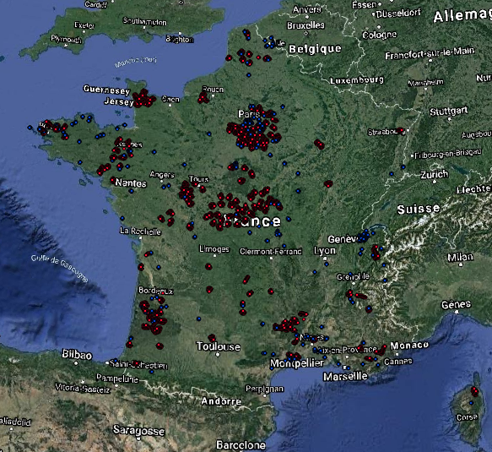
Vigie-Chiro: 3 different data collection protocols
Car transects
Walk transects
Full-night
10 x 2 km / 25 km/h
10 points / 2x2 km squares
1 - 10 points
/ squares 2x2 km
Starting 2006
Starting 2014
Currently : 567 participants!
208 car transects
219 walk transects
16 349 points (49 909 nights)
Notes:
Before implementing it in a web portal

Slide 4
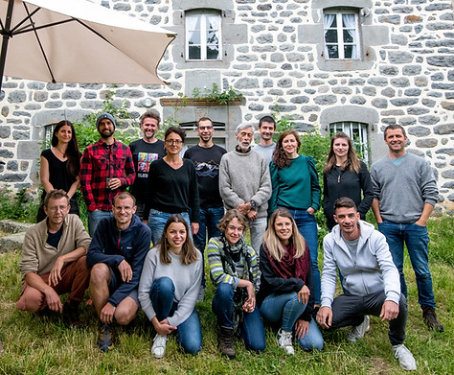
Vigie-Chiro: 3 different data collection protocols
Why such a success?
1.
2.
3.
Notes:
Before implementing it in a web portal

Slide 5
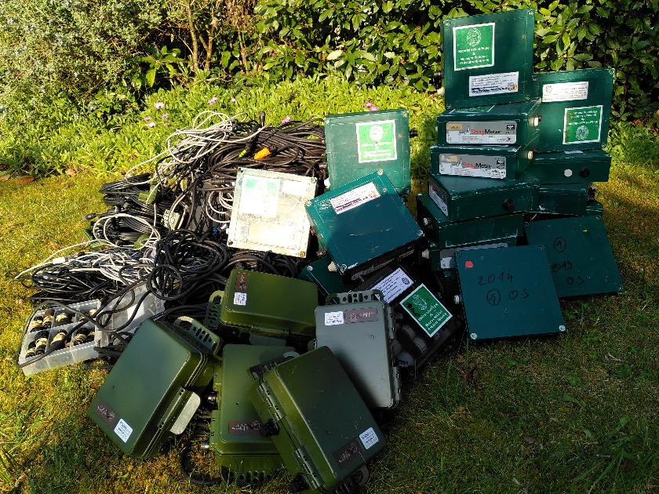
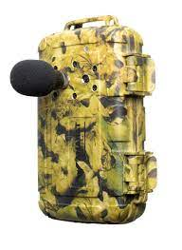
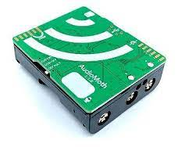
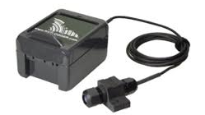
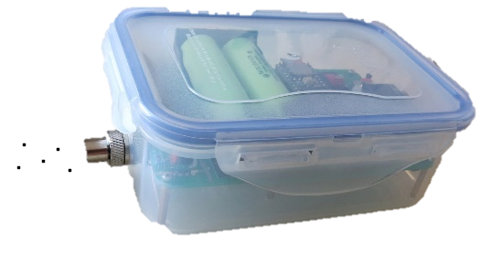
Vigie-Chiro: different ways to take part
One setting for each machine (here full-night protocols):
SM2BAT, SM3BAR, SM4BAT, SM Mini
Batlogger
Passive Recorder
Anabat Swift
Audiomoth
To obtain comparable measures
2 participation possibilities :
Representative protocol : random square choice
Opportunistic : squares are chosen by participants
Notes:
Before implementing it in a web portal

Slide 6
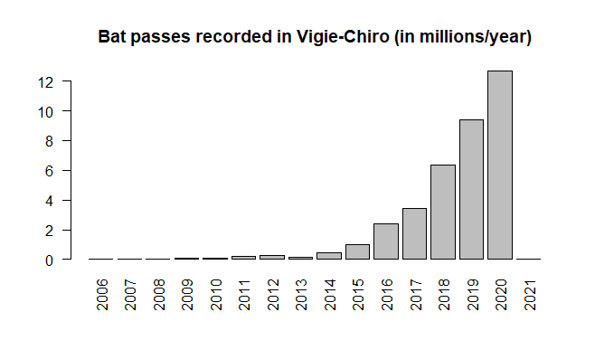
Why using automatic id?
~20000 bat passes /year
100% manually checked
Machine learning development
Implemented in a web portal
Notes:
Before implementing it in a web portal

Slide 7
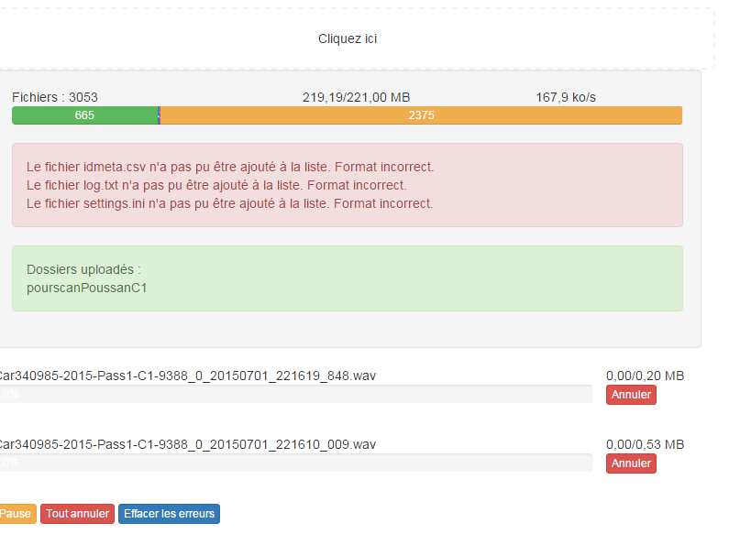
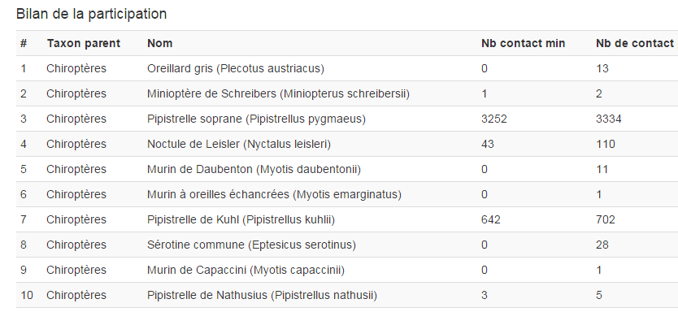
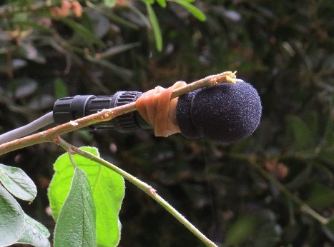
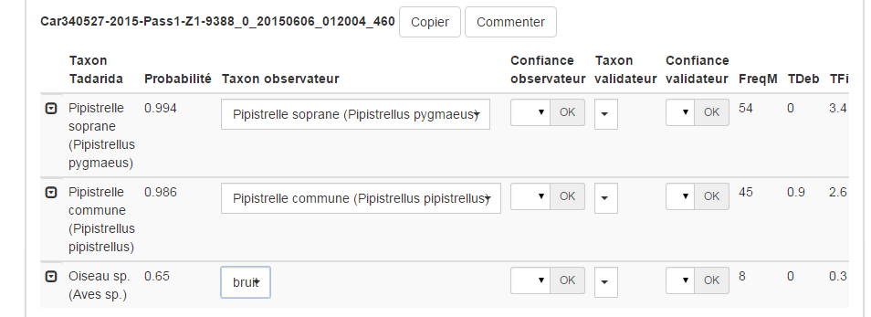
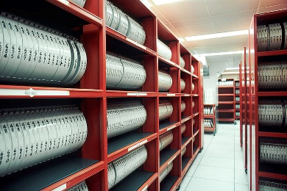
How to use auto id?
The example of Vigie-Chiro/Tadarida pipeline
Web portal
vigiechiro.herokuapp.com
Data collection
Data processing
(Tadarida OpenSource software)
Automatic feedback
Online data
transfer
Online manual checking
github.com/Scille/vigiechiro-front
Automatic secure storage (iRODS - IN2P3)
github.com/Scille/vigiechiro-api
Notes:
So our pipeline looks like this. People collect and upload data on our web portal. It is then stored in the long term on magnetic bands in IN2P3 facilities, and it is processed through machine learning software toolbox that we developed, called Tadarida

Slide 8
How to use auto id?
Tadarida-C
3 Random Forest classification layers:
Classification per calls based on acoustic features
Classification of sequences (number of species within a file)
Contextual classification : error correction with full-night sampling information (scores of other species, ratio of species occurrences)
AUC = 0.885
AUC = 0.967
This last layer is based on 92 720 collaborative checkings among participants !
Checking is stimulated through training sessions, currently a 2-hour training session each month
Notes:
6 min (5:03)
But this is now a little bit more sophisticated with 3 layers of classification. To the first layer classifying each calls according to acoustic features, we added another random forest classification that help grouping calls and then kind of decide the number of species within a file
More interestingly, we added in 2018 a contextual classification layer that use summary data on the full night to correct misidentification, such as relative abundance of each species, and score distribution among multiple detection event of each species

Slide 9
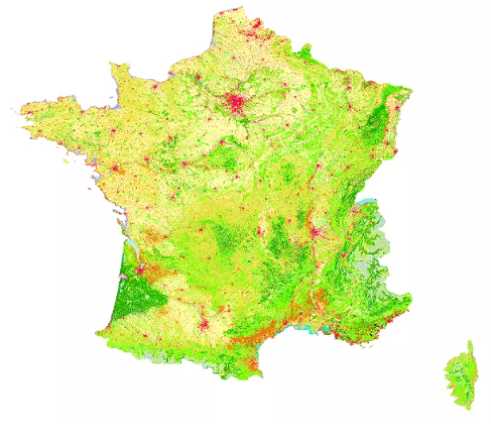
How to ensure good data?
Protocols for participants to test microphones AND processes for us to detect failing microphones!
The sampled habitats are representative of the french habitats, except in the car-transects (only on roads!)
CORINE Land cover map
Notes:
Before implementing it in a web portal

Slide 10
How to ensure good data?
Variability in data due to measurement or analysis → Noise
e.g. Errors in species ID
Noise = Problem ? Law of large numbers: imprecision is always compensable with the quantity of data collected
Biases appear in results when noise is correlated with the studied variables
e.g. if the Noctule bat is more often mixed up with the Serotine bat in forests than in prairies → Studies on the effect of the habitat on bat activity could lead to possible biased results
BUT if this correlation is small enough, then the bias could be insignificant! If it is measurable, then the bias can be corrected!
→ With big datasets it is important to replicate the analyses with different ways of accounting for errors to test the robustness of results (Barré et al., 2019)
Notes:
You can set the threshold at varying scores according to a trade-off between false positive rate and the quality of your activity estimate

Slide 11
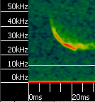
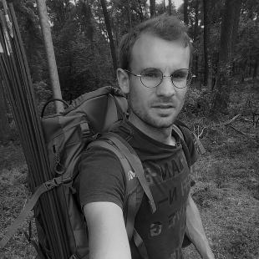
Accounting for errors
Is it possible to answer ecology questions with Auto-ID?
→ Identify thresholds to sort out « poor quality » data
Ludovic Jouve
correct identification probability
Checked id ~ auto id score
11% false positives but restricted to low Auto id scores
Barré et al. (2019) MEE
Auto id score
Notes:
Indeed, Tadarida-C shows 11% error rate on this species and on this dataset but all errors have low scores

Slide 12
Accounting for errors
Is it possible to answer ecology questions with Auto-ID?
→ Identify thresholds to sort out « poor quality » data
Ludovic Jouve
Remove error risk > 10%
=> Activity underestimated but less false positives
correct identification probability
Checked id ~ auto id score
Remove error risk > 50%
=> Best activity estimates
Barré et al. (2019) MEE
Auto id score
Notes:
You can set the threshold at varying scores according to a trade-off between false positive rate and the quality of your activity estimate

Slide 13
Accounting for errors
Is it possible to answer ecology questions with Auto-ID?
→ Identify thresholds to sort out « poor quality » data
Ludovic Jouve
Rate of false positives
100 % (Raw data)
50 %
10 %
→ Ecological response is robust
Barré et al. (2019) MEE
Notes:
You can set the threshold at varying scores according to a trade-off between false positive rate and the quality of your activity estimate

Slide 14
Accounting for errors
Is it possible to answer ecology questions with Auto-ID?
Identify thresholds to sort out « poor quality » data
Validate with an independent dataset
Roemer et al. (in preparation)
Notes:
You can set the threshold at varying scores according to a trade-off between false positive rate and the quality of your activity estimate

Slide 15
Results

Slide 16
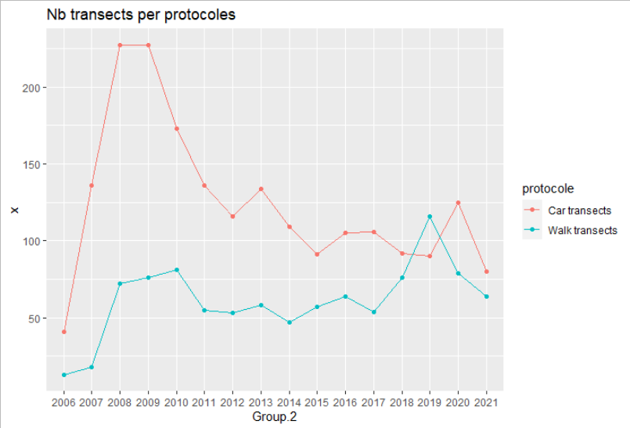
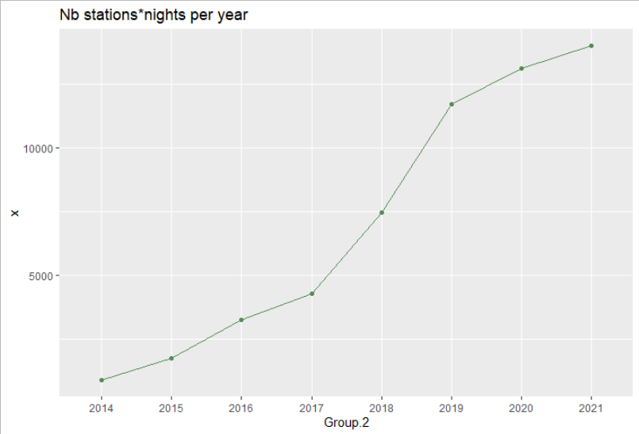
Vigie-Chiro dataset
Notes:
You can set the threshold at varying scores according to a trade-off between false positive rate and the quality of your activity estimate

Slide 17
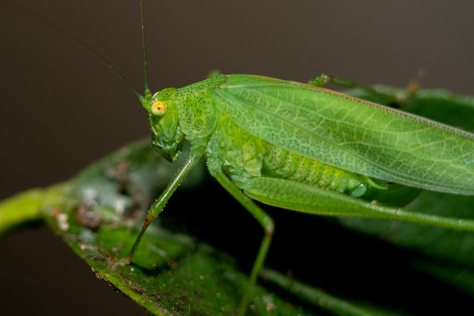
Population trends
This dataset shows significant declines during this period:
Nyctalus noctula -42 to -73%
Pipistrellus nathusii -15 to -59%
Eptesicus serotinus -16 to -42%
Pipistrellus pipistrellus -19 à -31%
P. kuhlii and N. leisleri are stable
…and significant decline for 4 bush-cricket species and 1 significant increase for Phaneroptera nana
Trends with weak statistical power towards increase for
Barbastella barbastellus
Plecotus austriacus
Myotis emarginatus
… and towards decline for
Miniopterus schreibersii
Myotis mystacinus
Notes:
You can set the threshold at varying scores according to a trade-off between false positive rate and the quality of your activity estimate

Slide 18
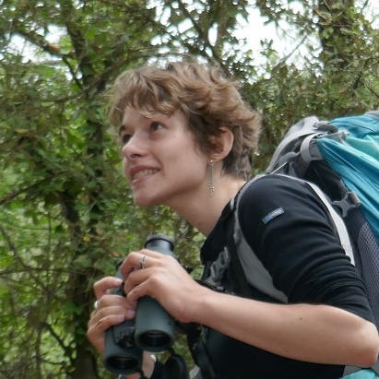
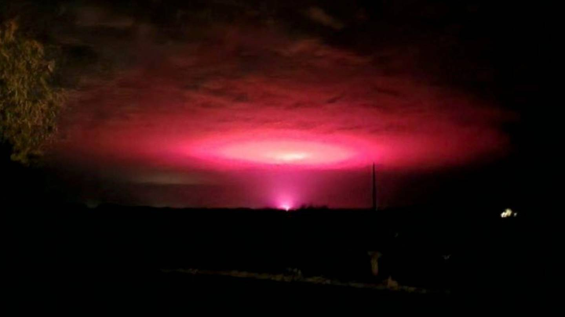
Studies on the anthropogenic impacts on bats
Léa Mariton
Effect of ALAN (Artificial Light At Night) on bat activity peak:
OR = delayed activity
+ = earlier activity
+ = ++delayed activity
© Tim Green
Mariton et al. (2022)

Slide 19
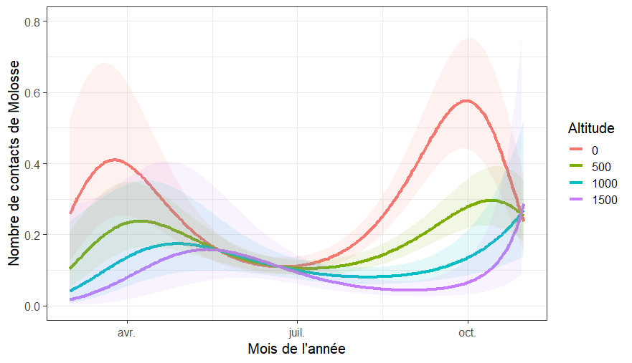
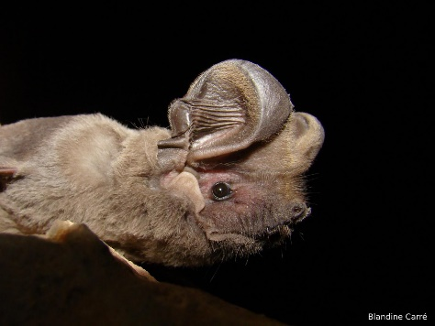
Ecology
Elevational seasonal migration ?
Vincent Robert
Blandine Carré
Elevation
N bat passes/night
April July October

Slide 20
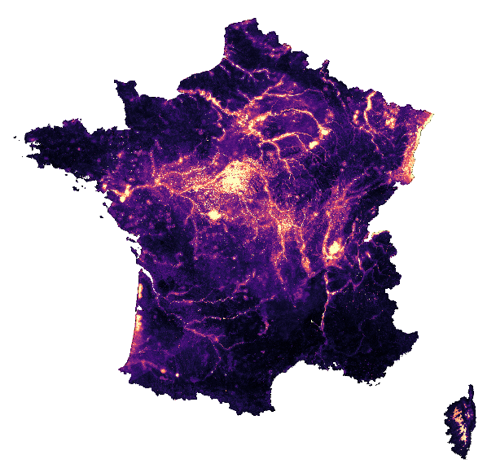
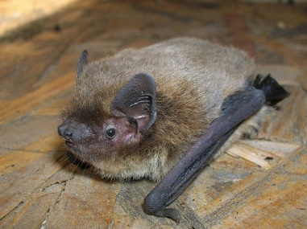
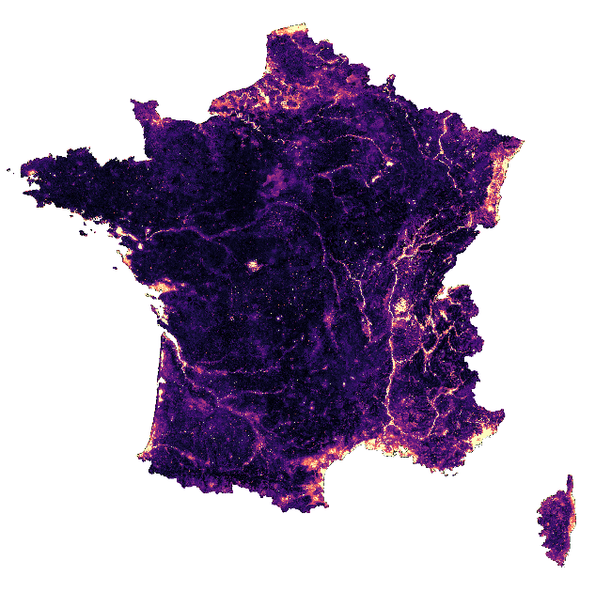
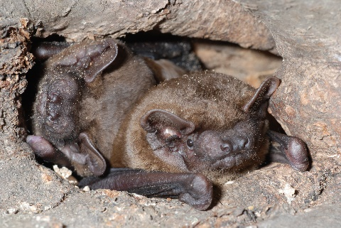
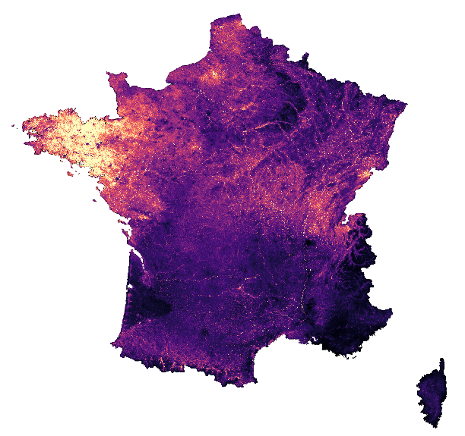
Using acoustic activity to map species relative abundance
Nathusius Pipistrelle
Common Pipistrelle
©Celine Le Barz
Noctule bat
©Charlotte Roemer
©Laurent Arthur
All maps available:
https://bit.ly/3d0PVhP

Slide 21
Bat migration routes in Europe: an acoustic venture

Slide 22
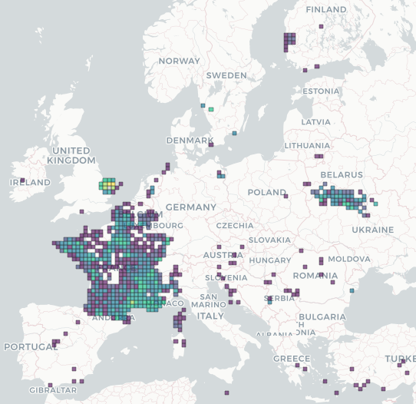
Project Bat migration routes in Europe
Collect acoustic data in Europe
WAV
Passive full-night recording
Identify activity hotspots
Assess zones of conservation priority
Maps for wind energy planning
Proof of concept for France
Invite other countries to join in

Slide 23
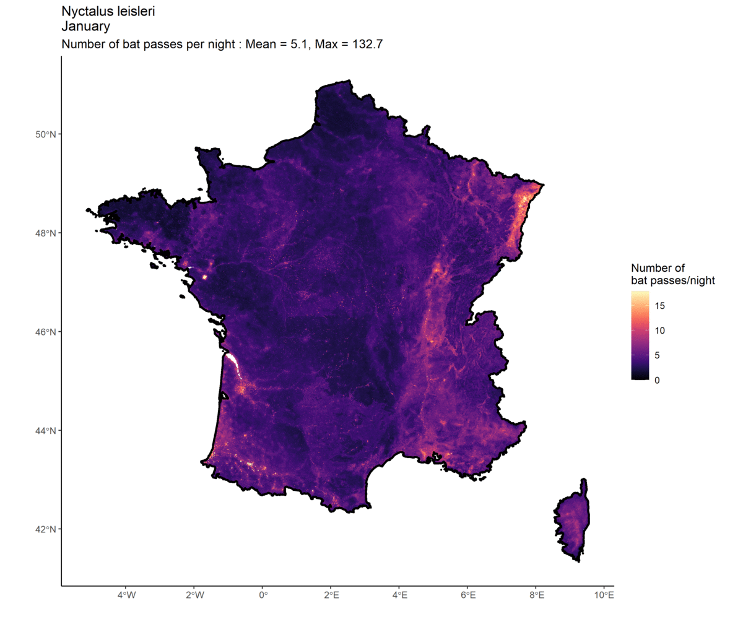
Project Bat migration routes in Europe
Identify activity hotspots
Leisler’s bat
Mindre brunfladdermus

Slide 24
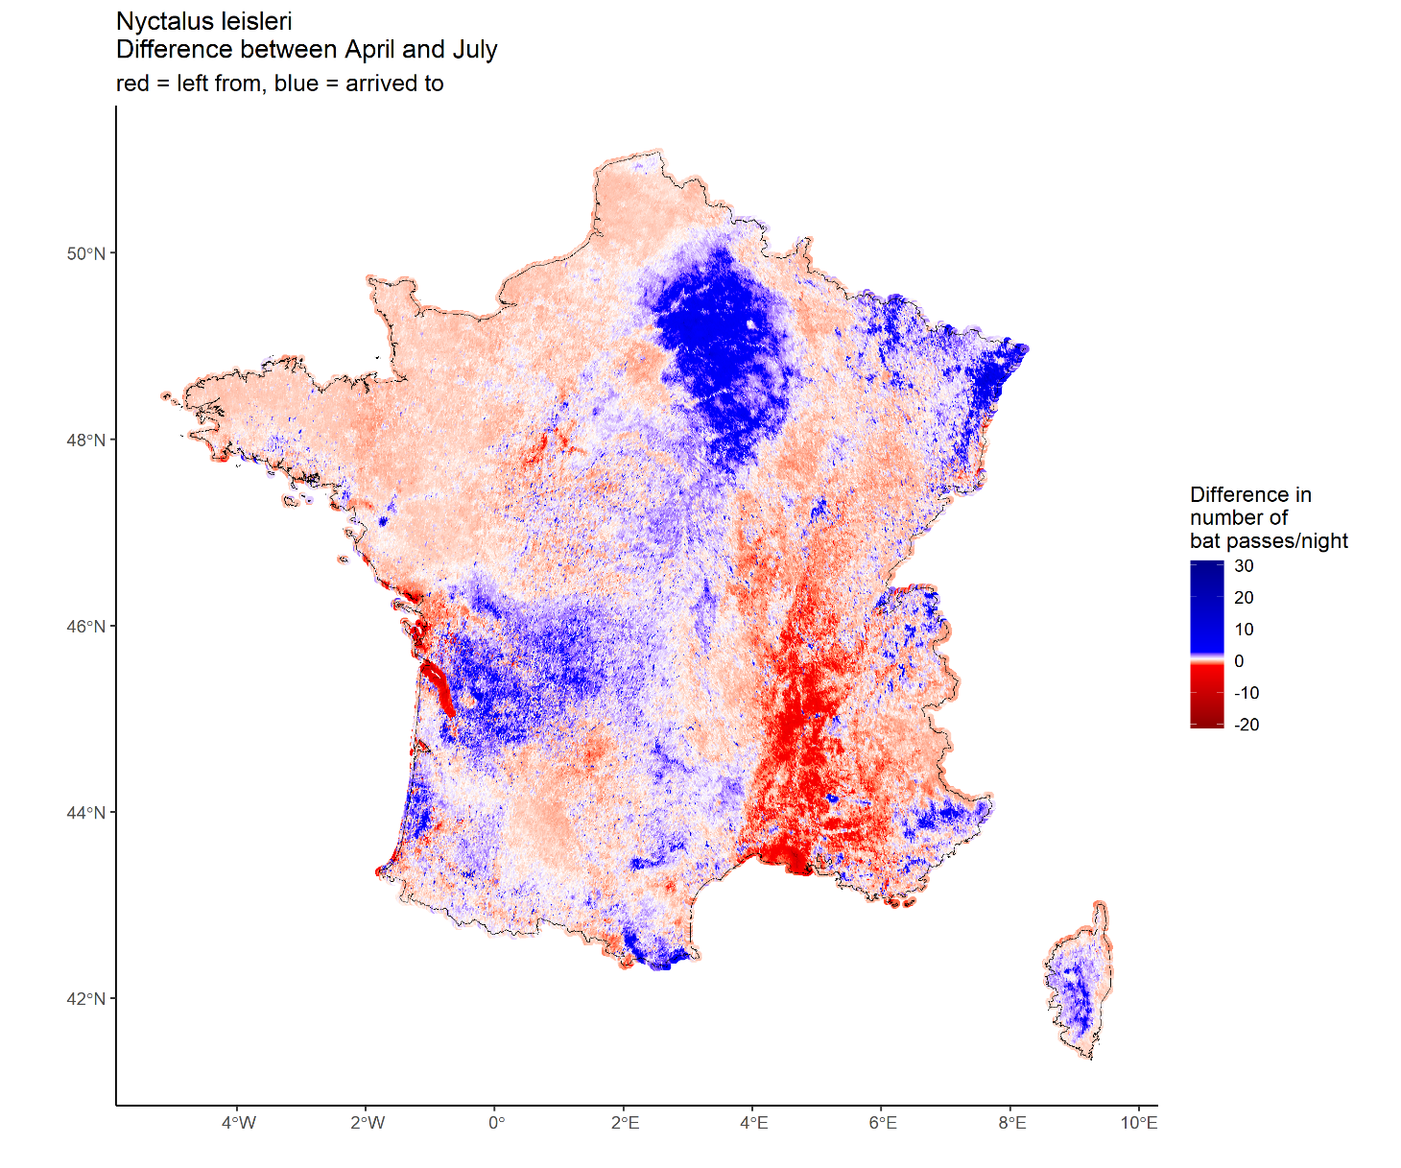
Project Bat migration routes in Europe
Identify activity hotspots
Spring
Leisler’s bat
Mindre brunfladdermus

Slide 25
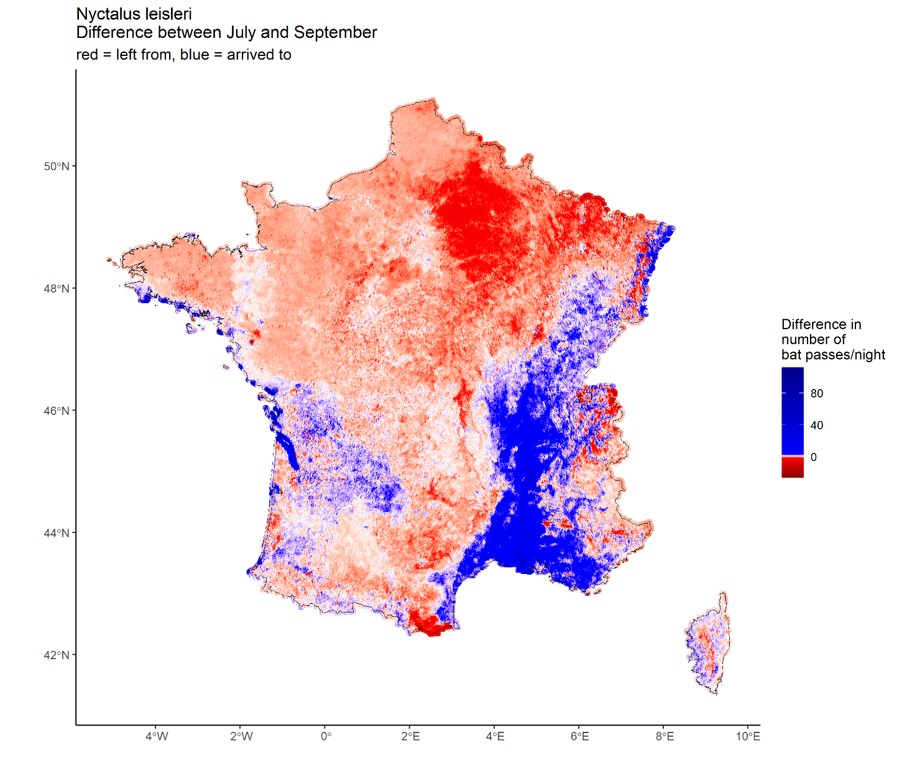
Project Bat migration routes in Europe
Identify activity hotspots
Autumn
Leisler’s bat
Mindre brunfladdermus

Slide 26
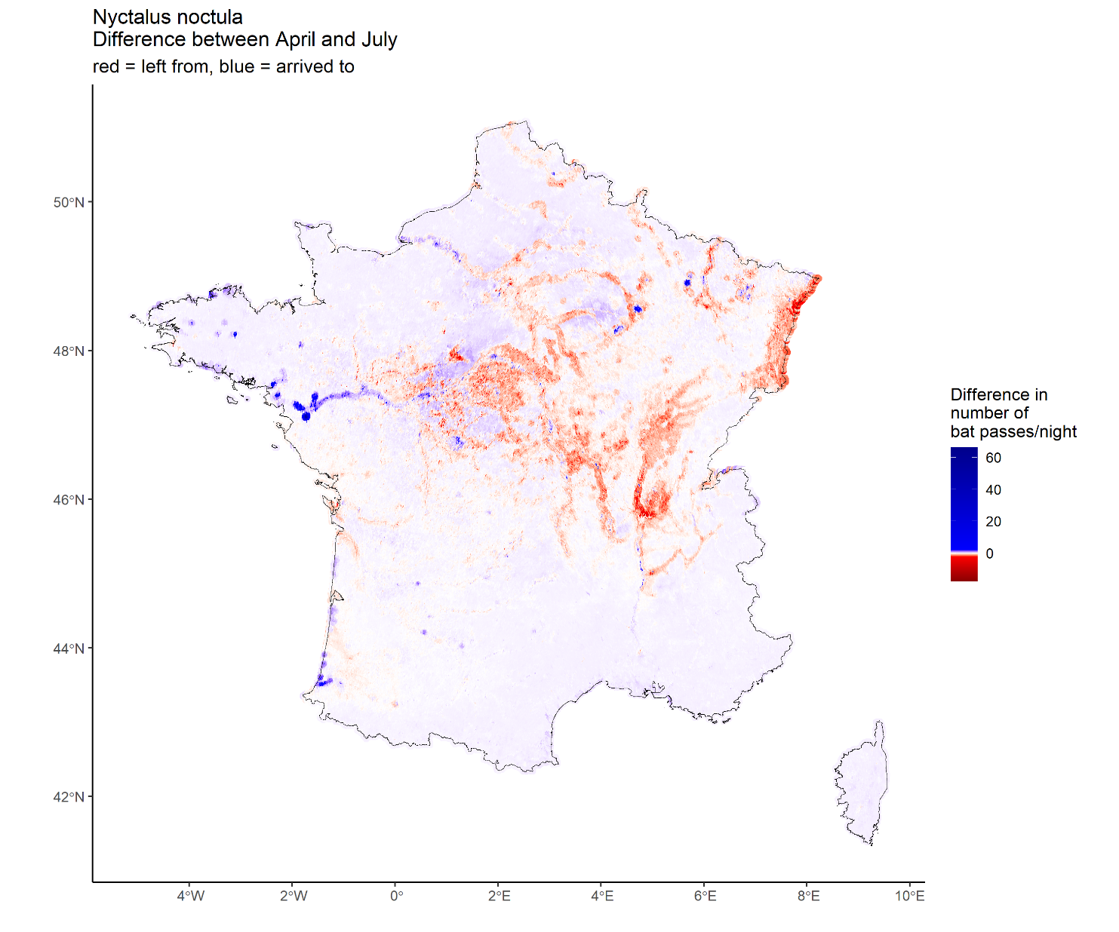
Project Bat migration routes in Europe
Identify spatio-temporal activity patterns
?
Noctule bat
Större brunfladdermus

Slide 27
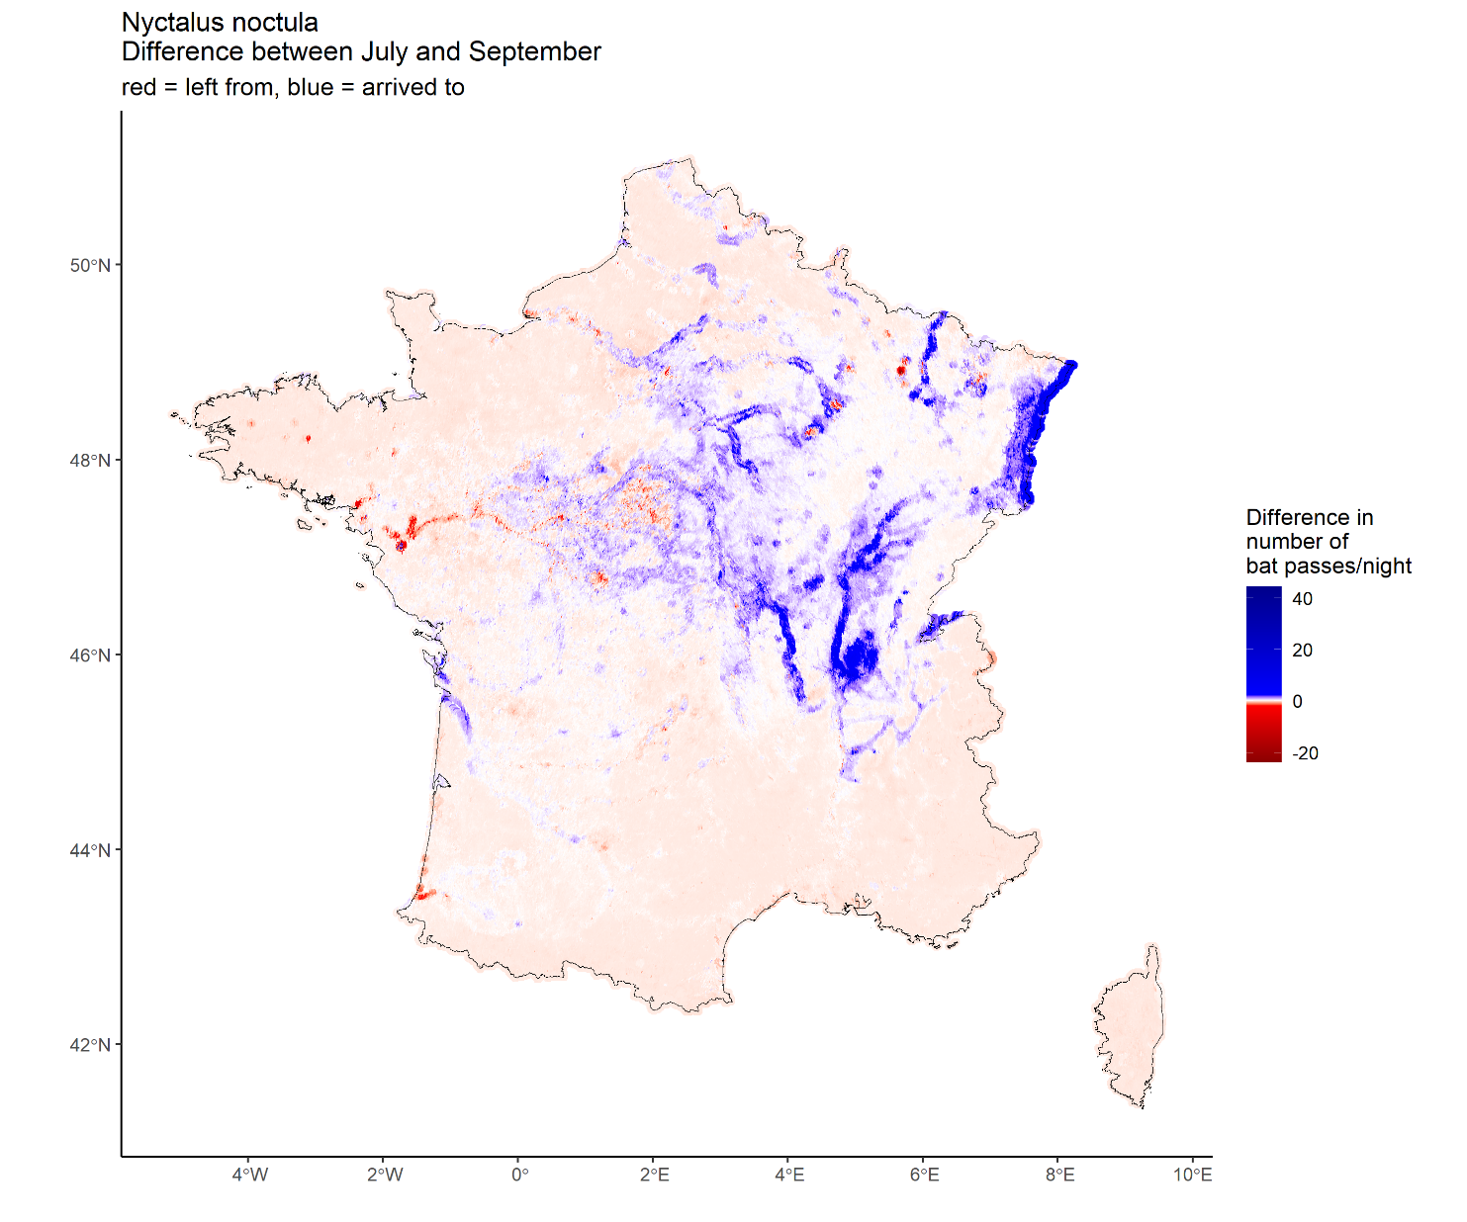
Project Bat migration routes in Europe
Identify spatio-temporal activity patterns
?
Noctule bat
Större brunfladdermus

Slide 28
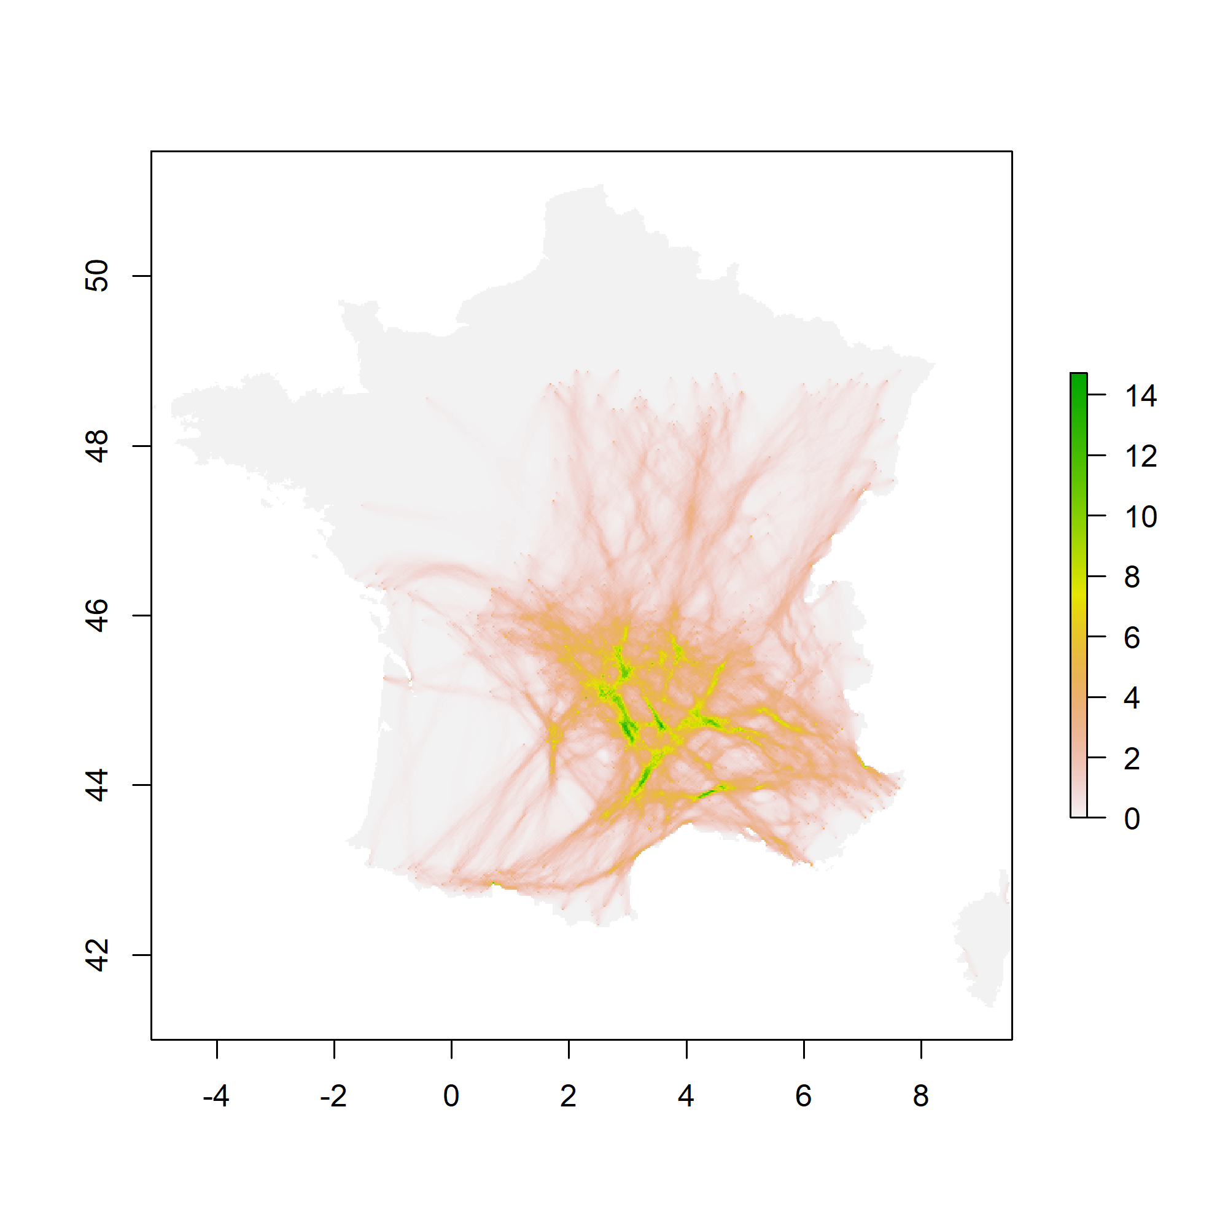
Project Bat migration routes in Europe
Calculate connectivity routes

Slide 29
Project Bat migration routes in Europe
You have full-night WAV recordings
We need you!
You remember which settings you used
Our guaranties:
The data you sent remains your property
The coordinates of your recordings will not be disclosed
You will be a co-author
Your opinion counts: feedback for methods, results and how to use the maps
You remember the coordinates
Optional: the recordings were made in countries where bat monitoring is scarce
You are willing to either send the WAV or to scan them with TADARIDA

Slide 30
Conclusion
Lessons learned:
Citizen science + auto id + free web services + participant training + collaborative checking = detailed data at unprecedented scales
Secure archiving of raw recordings → re-analyse the data with up-to-date tools
Common species automatic identification is easy, rare species need a semi-automatic process with expert checking
2) Prospects: improving auto id
More reference data => collaborative work needed
Adding audible frequencies in the process (nocturnal birds, frogs, ground-crickets, etc)
Adding geographic distribution as a criterion
Notes:
And of course thanks to all of you for your attention!

Slide 31
Conclusion
3) International collaboration:
Bring « dead data » back to life + co-authorship = main motivations
Data collected can be useful for other research & conservation projects
A big obstacle is standardisation: « old » citizen science programmes in Europe have comparable settings…but future programmes might not!
What about an international portal?
Notes:
And of course thanks to all of you for your attention!

Slide 32
Many thanks to all volunteers participating in Vigie-Chiro!!!
Thanks also to people helping in the IT process:
Didier Bas, Emmanuel Leblond, Pascal Calvat, Yvan le Bras, Naïma Khrouz, Cécile Callou
Tack för din uppmärksamhet!
And many thanks to Johnny de Jong and BatLife Sweden for their kind invitation!
charlotte.roemer1@mnhn.fr

Slide 34
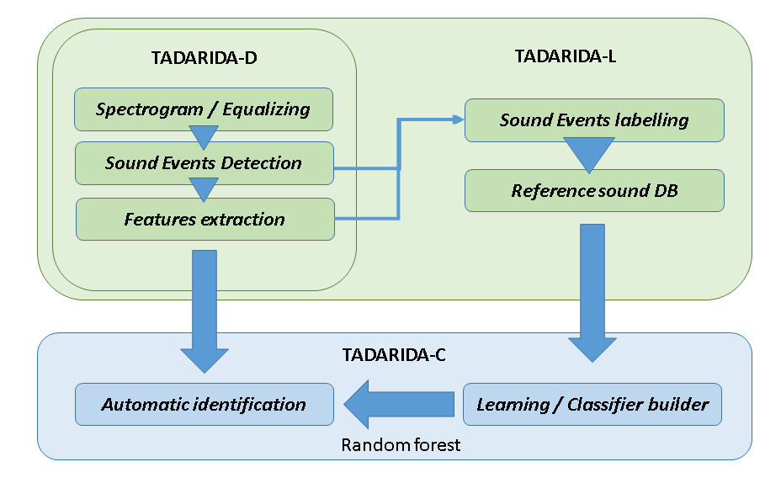
How using auto id?
The example of Tadarida open software
Generic time/freq. segmentation
Graphical interface to quickly label sound events
1 115 909 to date / 21365 files
Extracting 271 numerical features per event, describing frequency / amplitude / rythm
Illustrations papiers alienor + stuart
Bas et al. (2017) JORS
Notes:
This toolbox comes in 3 modules, a first one, Tadarida-D, involving a generic sound event detection extracting numerous features
It is complemented by a second module, Tadarida-L,

Slide 35
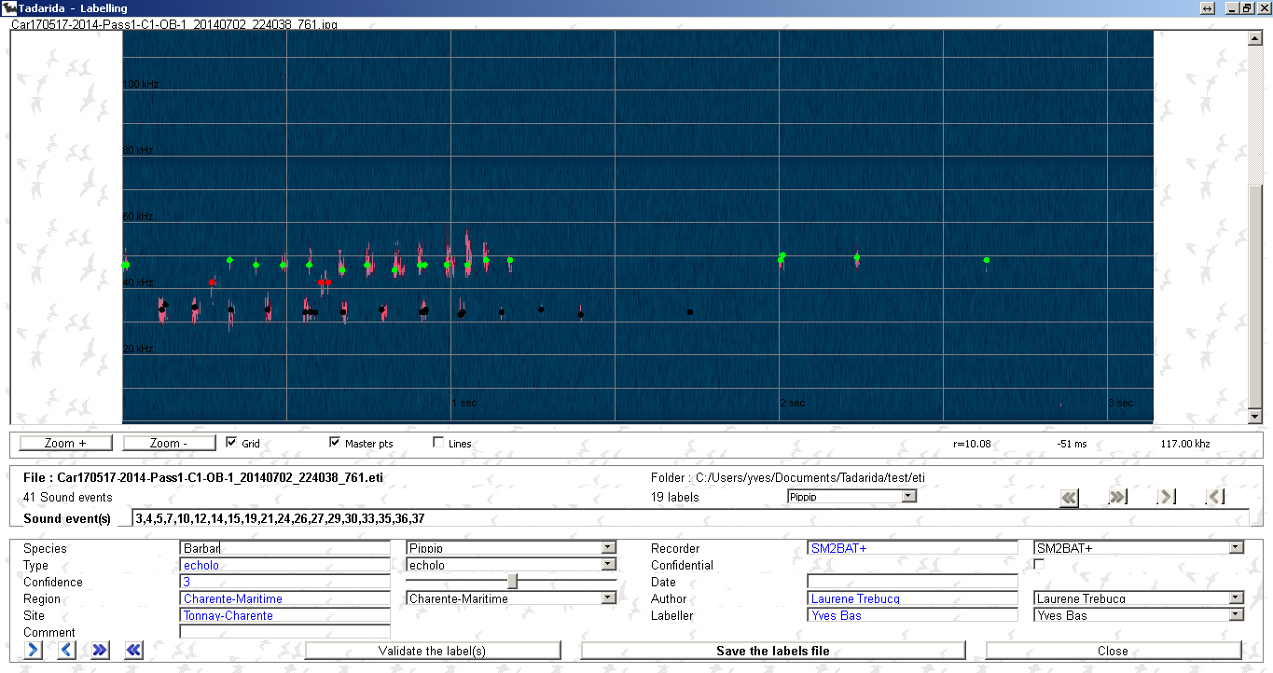
How using auto id?
The example of Tadarida open software
Generic time/freq. segmentation
Graphical interface to quickly label sound events
1 115 909 to date / 21365 files
Extracting 271 numerical features per event, describing frequency / amplitude / rythm
Illustrations papiers alienor + stuart
Bas et al. (2017) JORS
Notes:
designed to efficiently label reference files through this interface where you can easily select multiple calls and tag them with species, location, behaviour features, confidence in the identification and so on.
This will build a sound reference data base

Slide 36
How using auto id?
The example of Tadarida open software
Generic time/freq. segmentation
Graphical interface to quickly label sound events
1 115 909 to date / 21365 files
Extracting 271 numerical features per event, describing frequency / amplitude / rythm
Illustrations papiers alienor + stuart
Random forest classification detecting simultaneously several species
Apply to any new data
Bas et al. (2017) JORS
Notes:
that will be used by the third module, Tadarida-C, relying on random forest classification. We described a first version in our 2017 paper

Slide 37
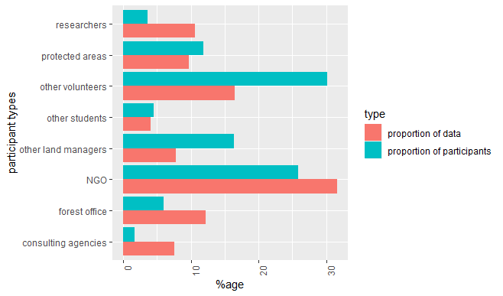
Vigie-Chiro: who’s participating?
Total to date: 495 participants!
NGOs & volunteers: 56% of participants / 48% of data
Land managers: 35% of participants / 29% of data
Researchers & consultants: 5% of participants / 19% of data
Notes:
To date, there are 500 people who participated in Vigie-Chiro
About half of the participants are volunteers and NGOs staff which are the main target of the programme
But we have also significant contributions from various land managers like the forest office, and also researchers and consultants

Slide 38
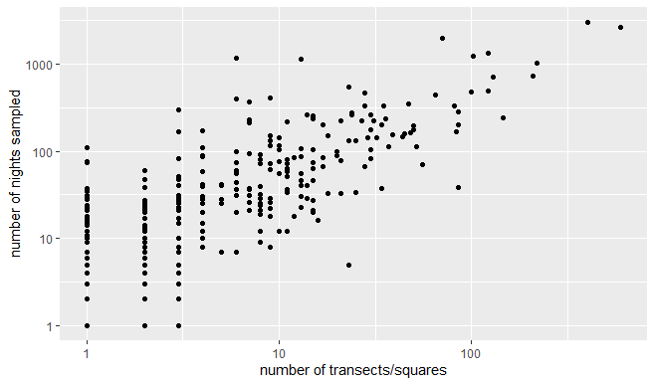
Vigie-Chiro: who’s participating?
% participants
% data
2
37
14
42
83
21
Participation is significant whatever the involvement!
Notes:
If we look at individual involvement, we see that there are 9 crazy participants that recorded bats during more than 1000 nights, basically by putting 5 to 10 recorders in the field most of the season !
Those people gathered 37% of the data but still “more normal” people with modest participation gathered more than 20% of the whole dataset, so participation is really significant whatever the level of involvement!

